Slide 1

Indian Institute of Management Bangalore
Bachelor of Business Administration in Digital Business and Entrepreneurship batch 2025-28
Steps for apply to the program

Slide 2
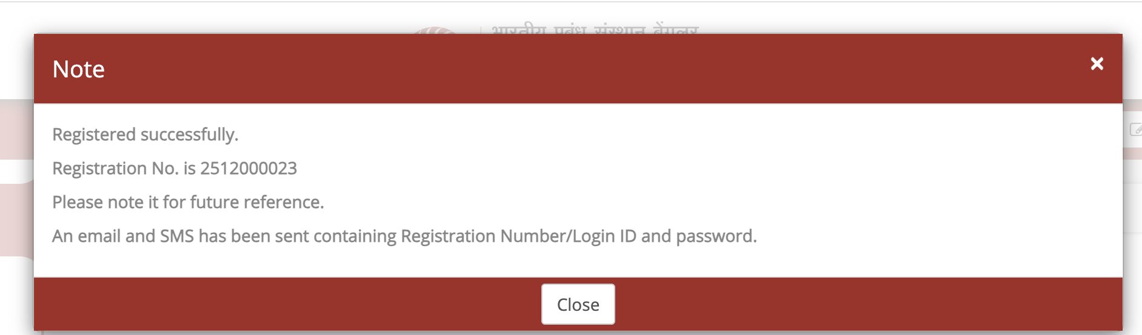
Step 1
Visit https://dbe.iimb.ac.in/
Register to the program with the registration link - https://cdn3.digialm.com//EForms/configuredHtml/33002/92519/Registration.html
After register to the program you will get the below mentioned confirmation
Ensure login credentials in your registered mailbox
Login to the program with the login link - https://cdn3.digialm.com/EForms/configuredHtml/33002/92519/login.html

Slide 3
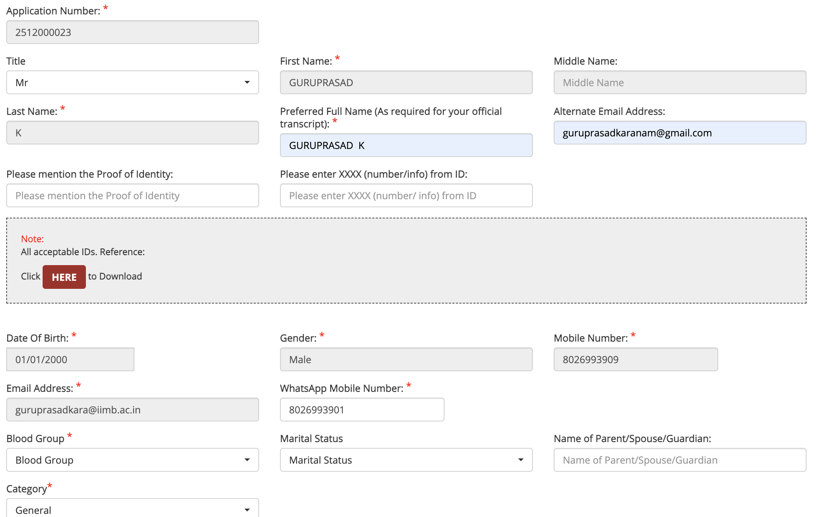
Step – 2 & 3 – Personal details and communication details
Fill your Personal details and be sure with all your all data specially with the category and annual income (once confirmed it cannot be changed).

Slide 4
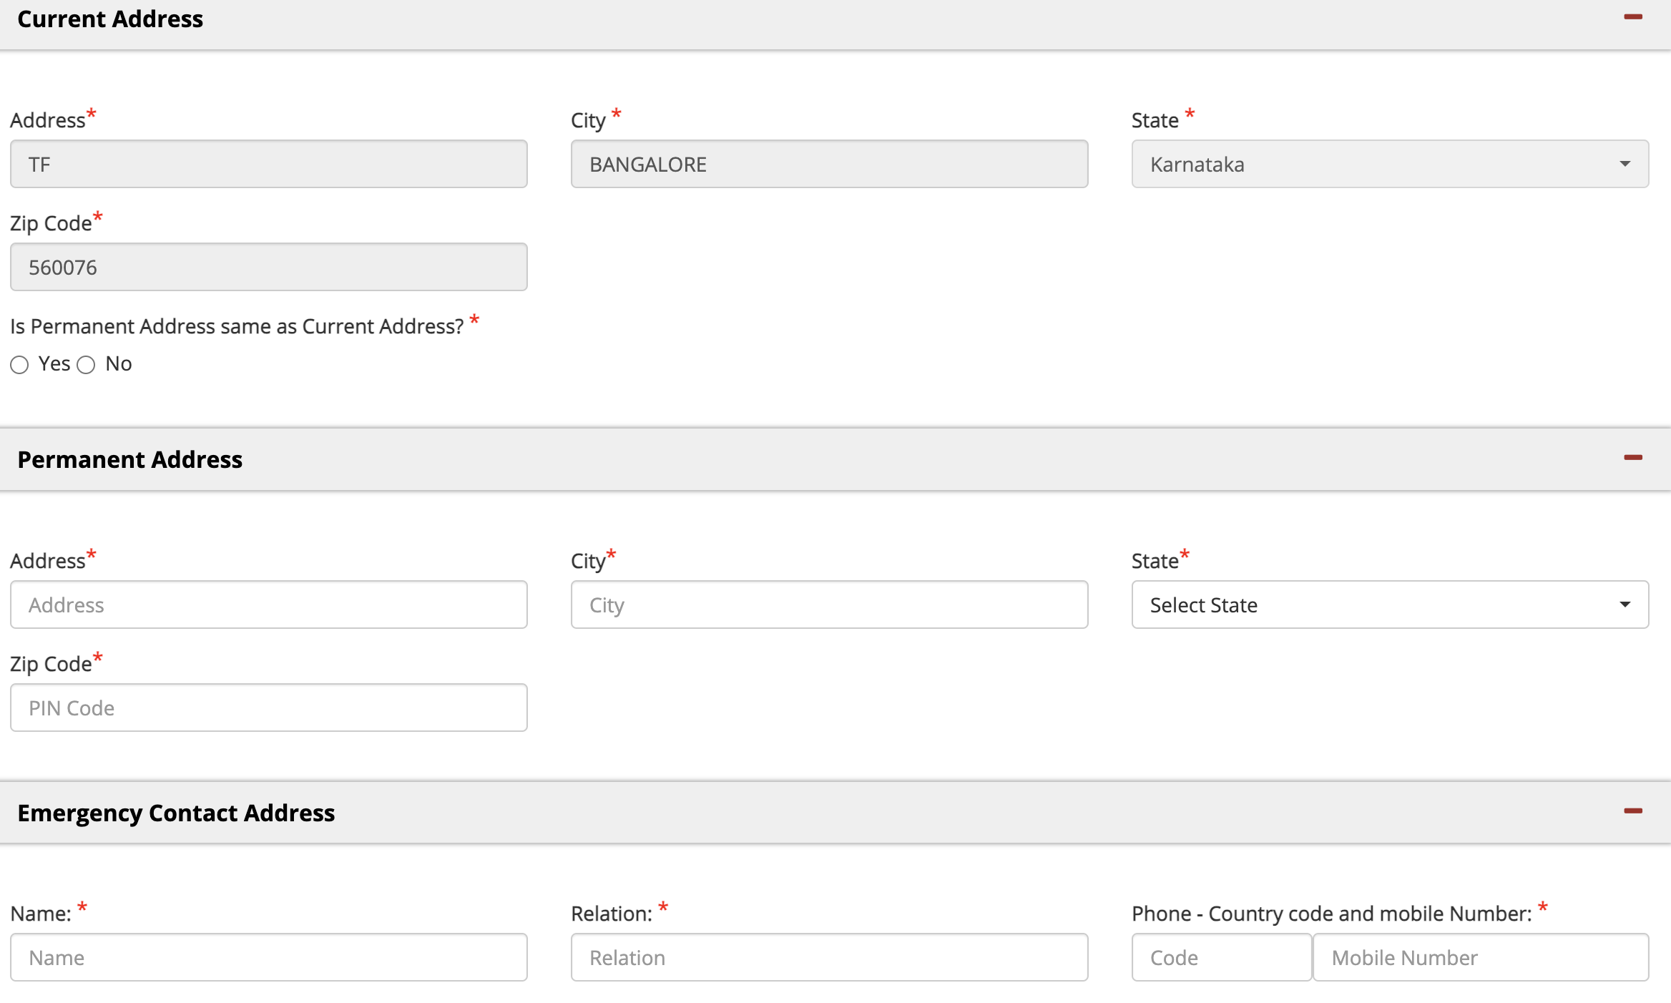
Contd…

Slide 5
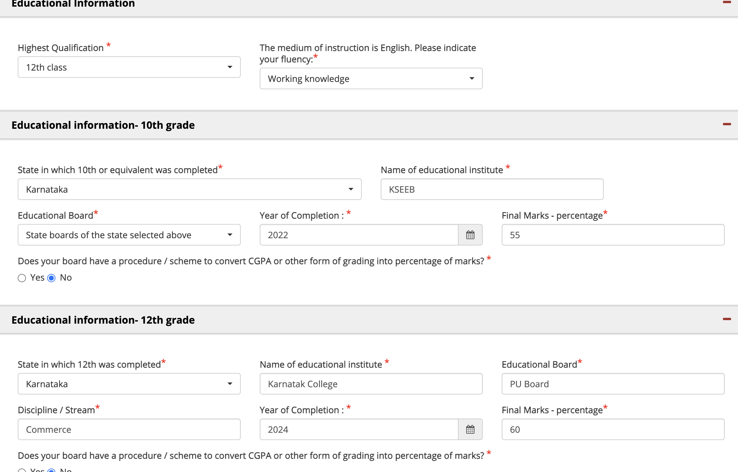
Step – 4 Educational Information (Read eligibility criteria in detail)

Slide 6
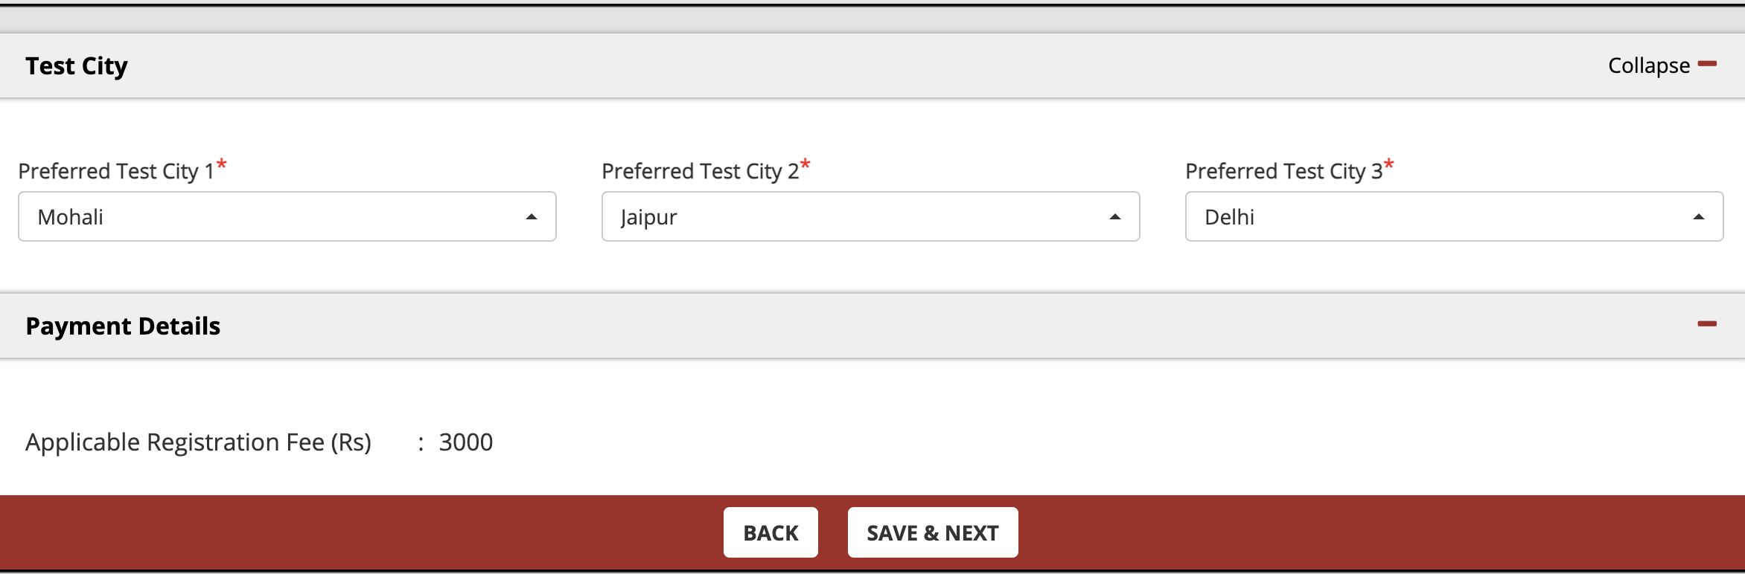
Step – 4 – Select your preferred city for Entrance Test and make the payment by using the payment link - https://enidhi.iimb.ac.in/?p_id=604D69D869A6FB82F2B947D6A9DA5820

Slide 7
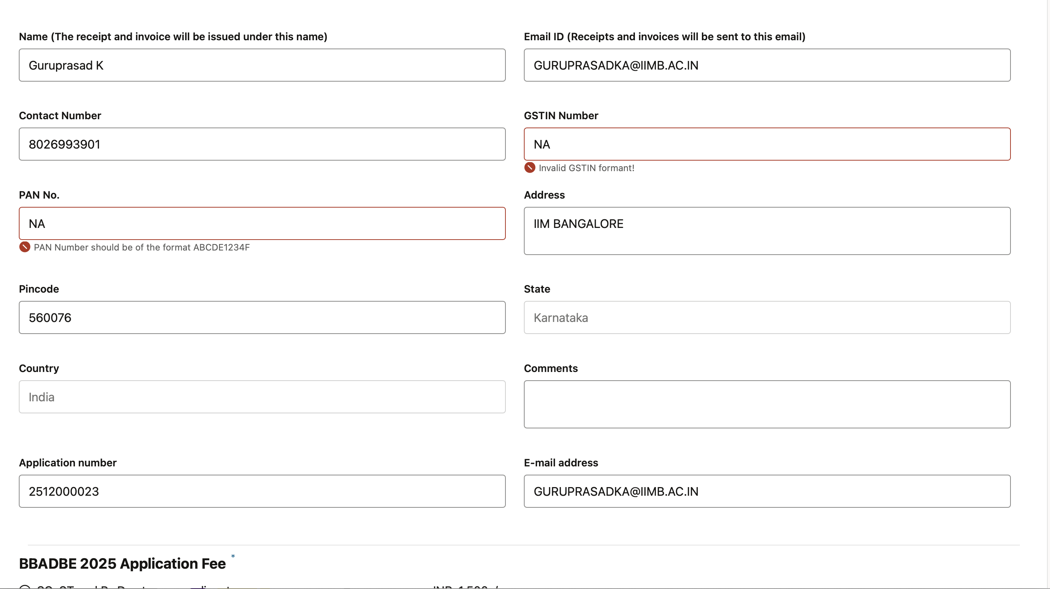
Step – 5 – Fill your registered mail id and registration number while making the payment and ensure to enter the details in the final step of application form

Slide 8
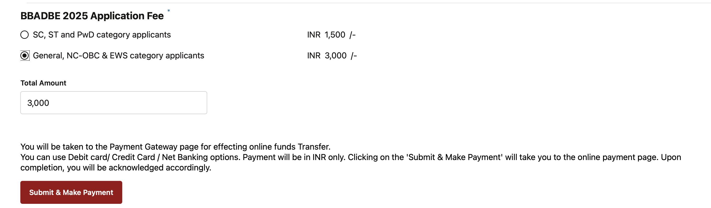
Contd…

Slide 9
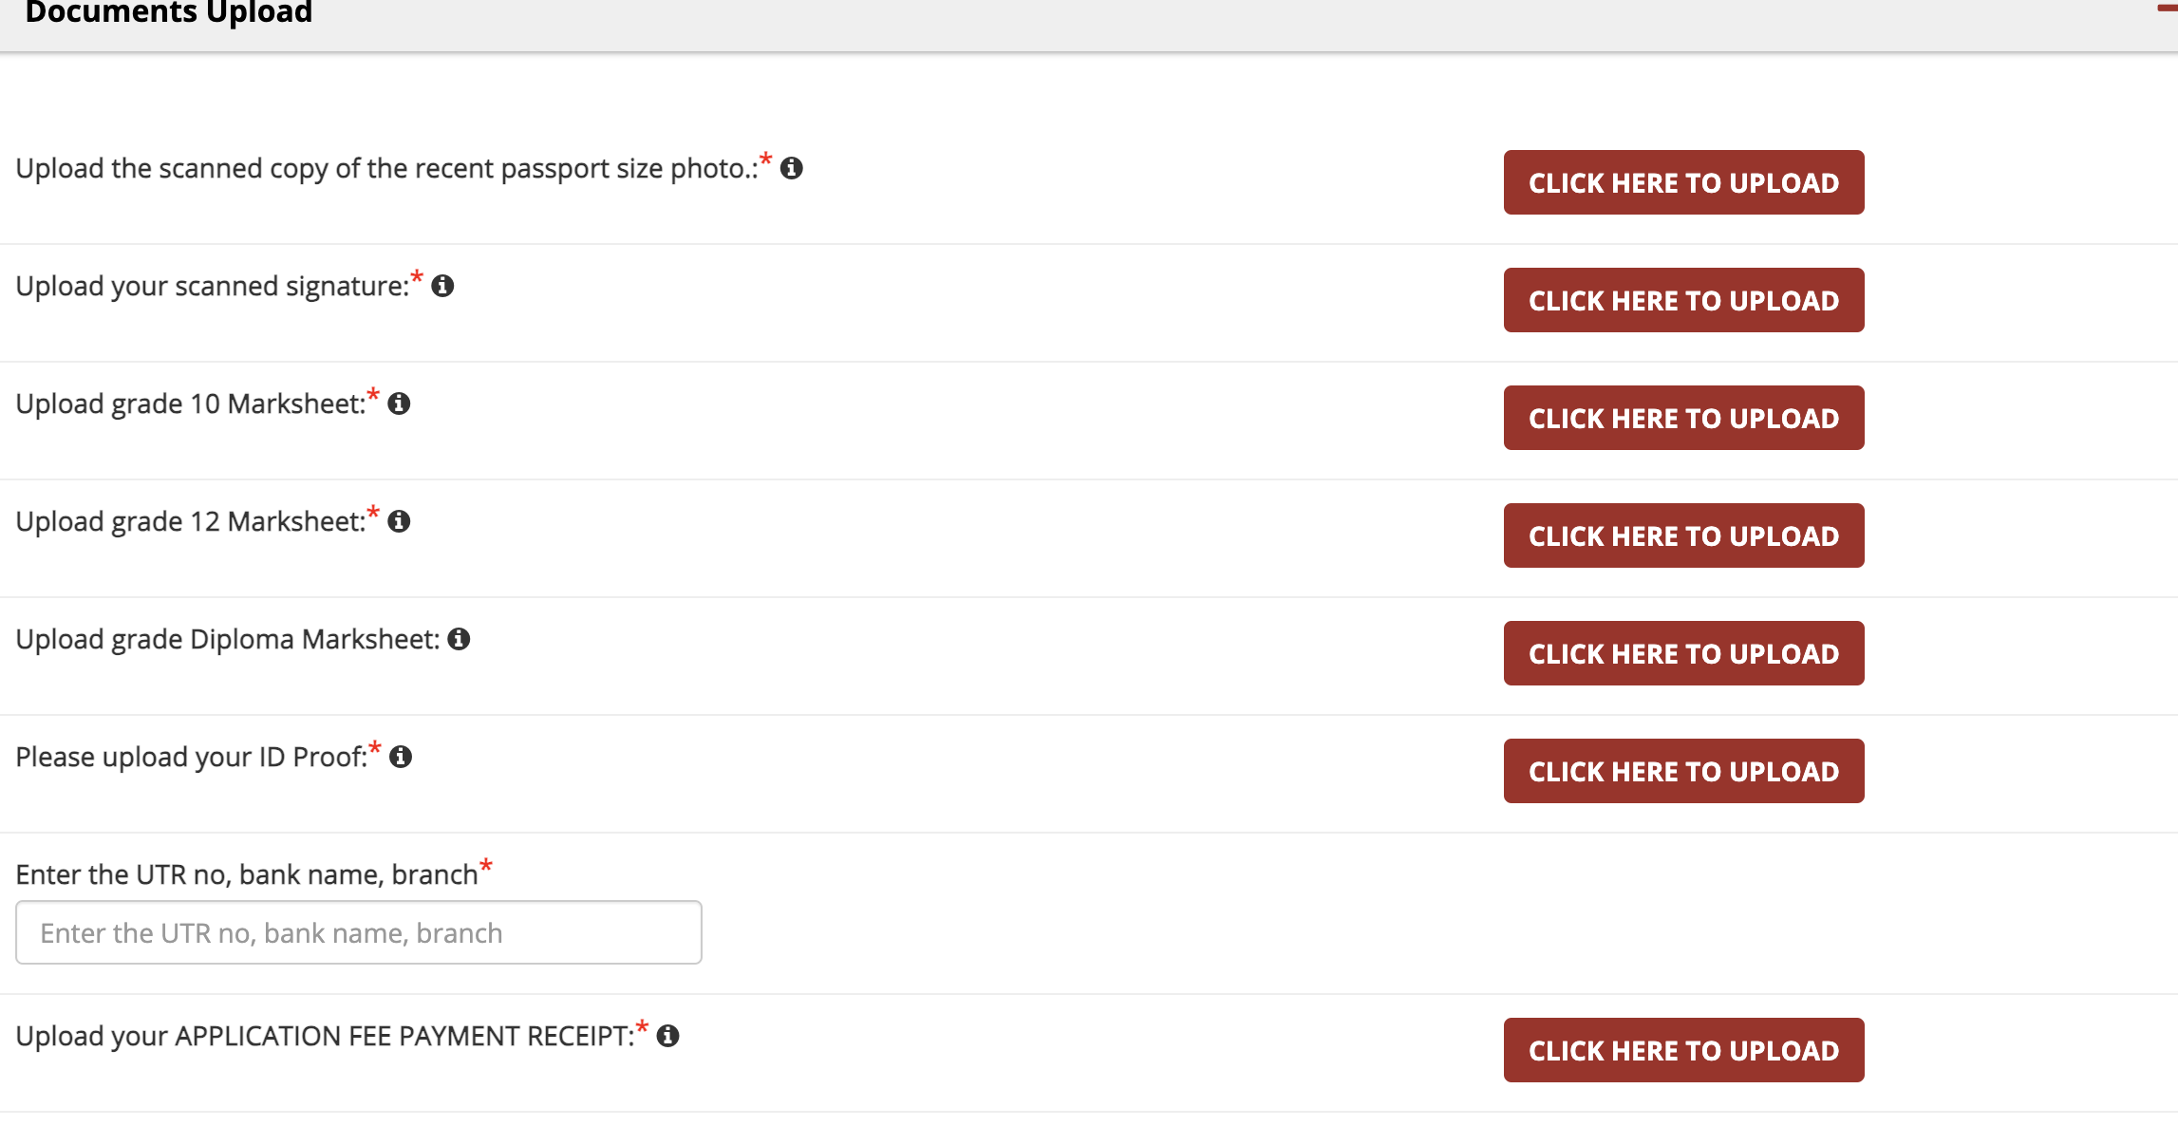
Final Step – Documents to be uploaded (Make ensure receipt of payment and enter the UTR details, Bank name and Branch)
`

Slide 10
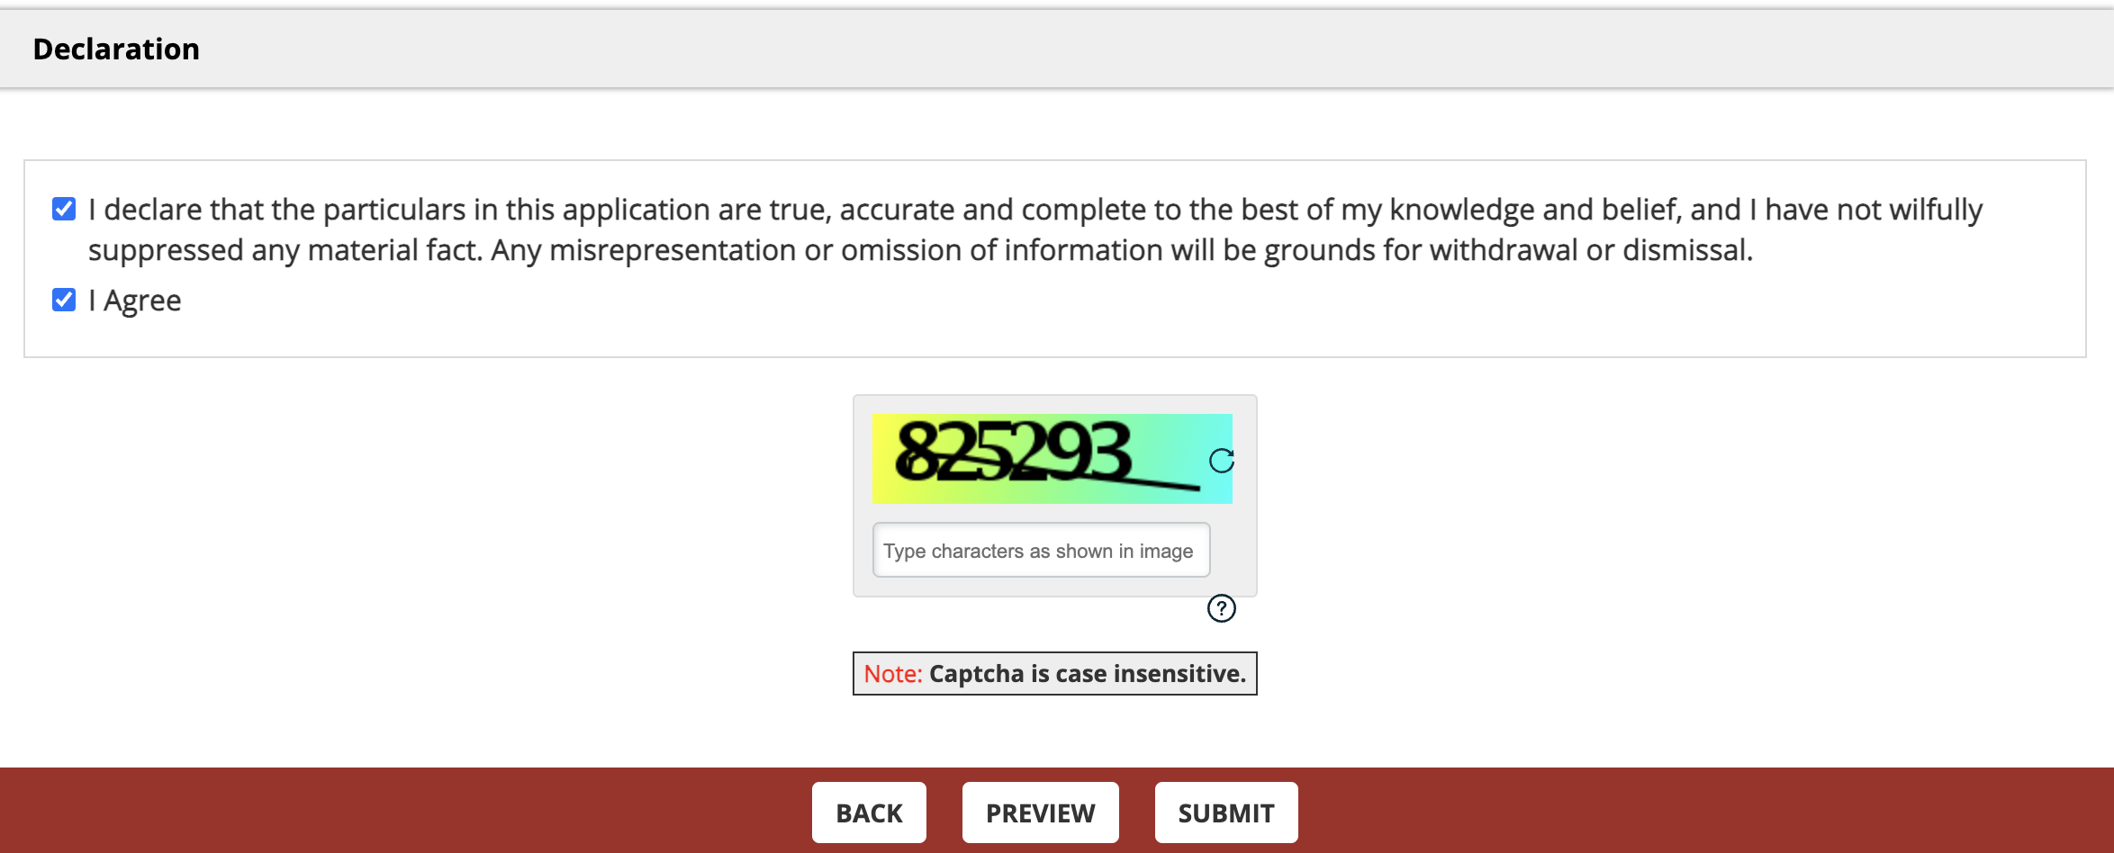
Contd…. Preview and submit the form, if you have any clarifications, please reach dbeadmissions@iimb.ac.in

